Slide 1
Building Improvements across the Link Academy Trust Summer term 2023
With 5 successful Capacity Improvement Fund ( CIF) bids this year we have seen a significant improvement in many of our schools
The Link has also instigated improvements using Trust Reserves and in the case of Diptford a loan for Urgent Capital Support (UCS)

Slide 2
Projects in alphabetical order-
Diptford
Following Storm Eunice Diptford’s two outdoor classrooms which were well past their lifespan were significantly damaged, one, we were unable to use at all as the roof had completely blown off. We then had to urgently seek funding to enable us to replace this teaching space. It certainly was not easy to achieve this and took nearly a year to get the Urgent Capital Support ( UCS) that has provided us with a loan to enable the building to start.
Staff were amazing and ‘managed’ learning effectively using the small spaces of the main school building and the village hall for more than a year.
Demolition of the old classrooms started as the children went into the Easter Holiday break and the new build started after that. After some teething problems in achieving good foundations, the builders were able to move on.
We expect to be in the new space by the second week of September. The new building is now on the same level as the main building with a connecting section, so pupils do not have to go outside when moving between the main school and new section. The new building two classrooms with modern toilets, break-out rooms and resource cupboards.
Look out for the Opening Celebration which we anticipate to be in place for early October!

Slide 3
Diptford Primary School
Replacement of the two dilapidated classroom huts with an extension to the main school, including additional space, toilets, break-out learning spaces and resource storage.

Slide 4
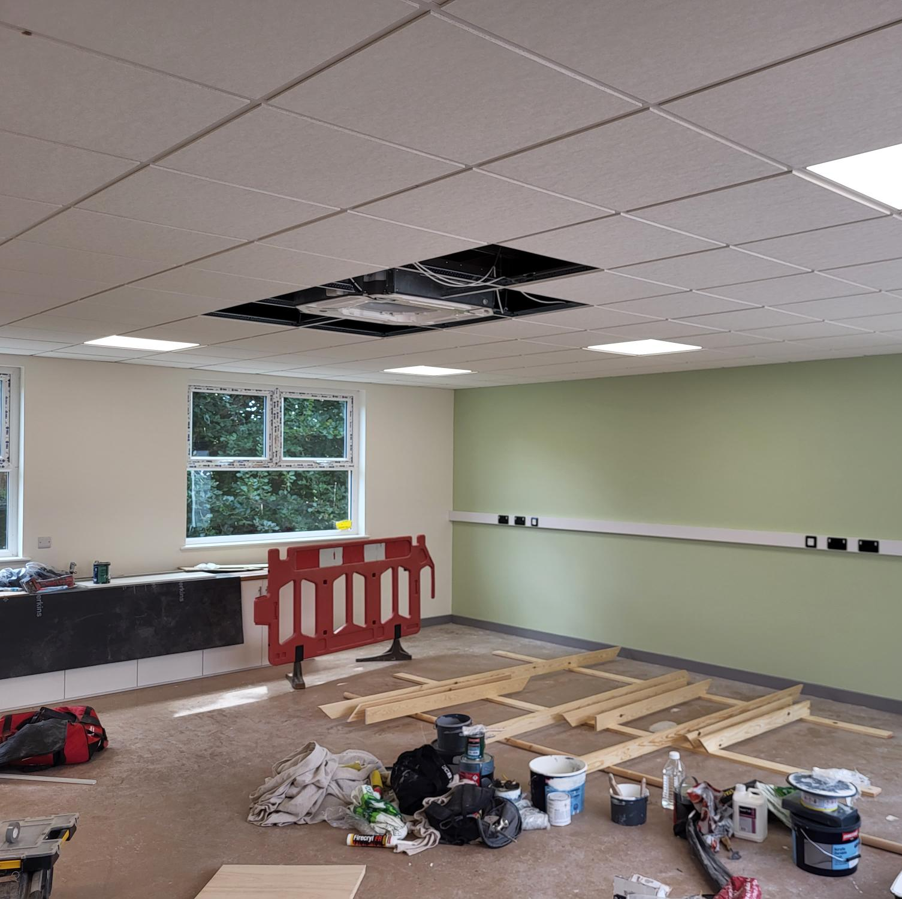
Classroom 1- just awaiting final fittings and flooring
New furniture will add the final touches and display boards and Smartboard are still to be installed

Slide 5
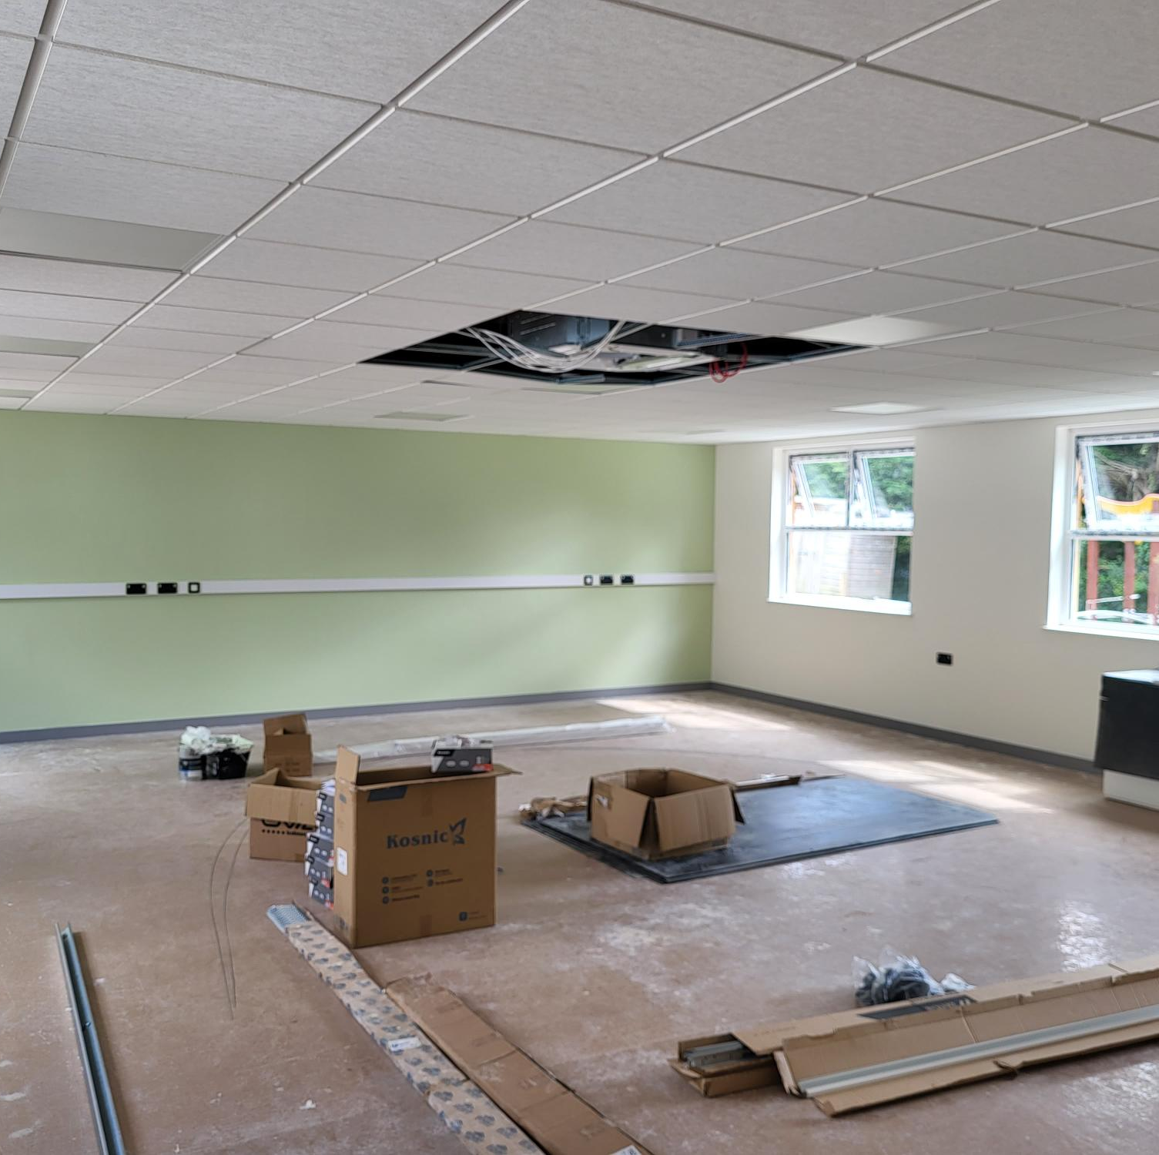
Classroom 2
This space is so much bigger it will enable us to have full school assemblies without having to leave the school.
We are expecting flooring at the end of August and await all new furniture.

Slide 6
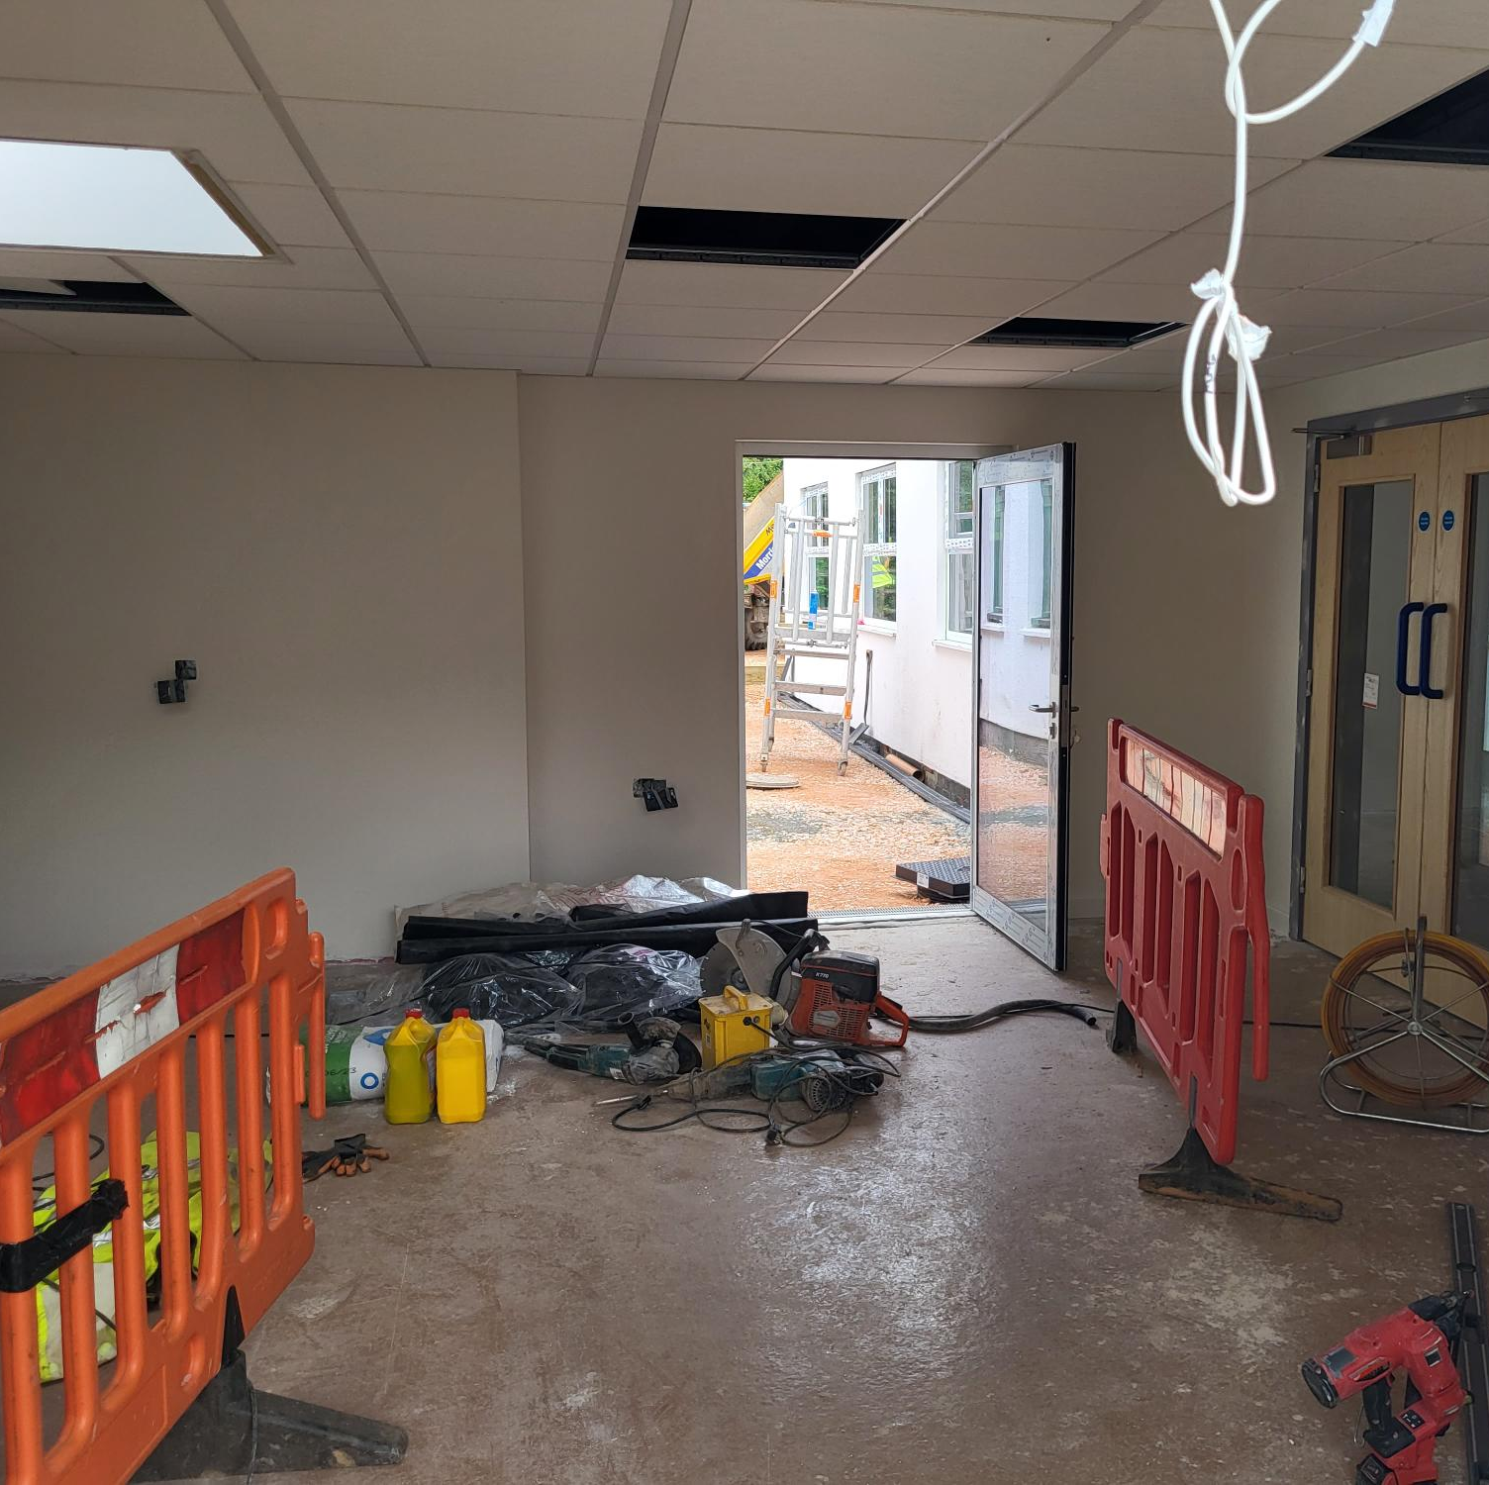
Foyer link between the new classrooms and the main school.
This new link has given us additional space and a covered connection to the main school.
Double doors lead out into the Early Years unit and the play area.

Slide 7
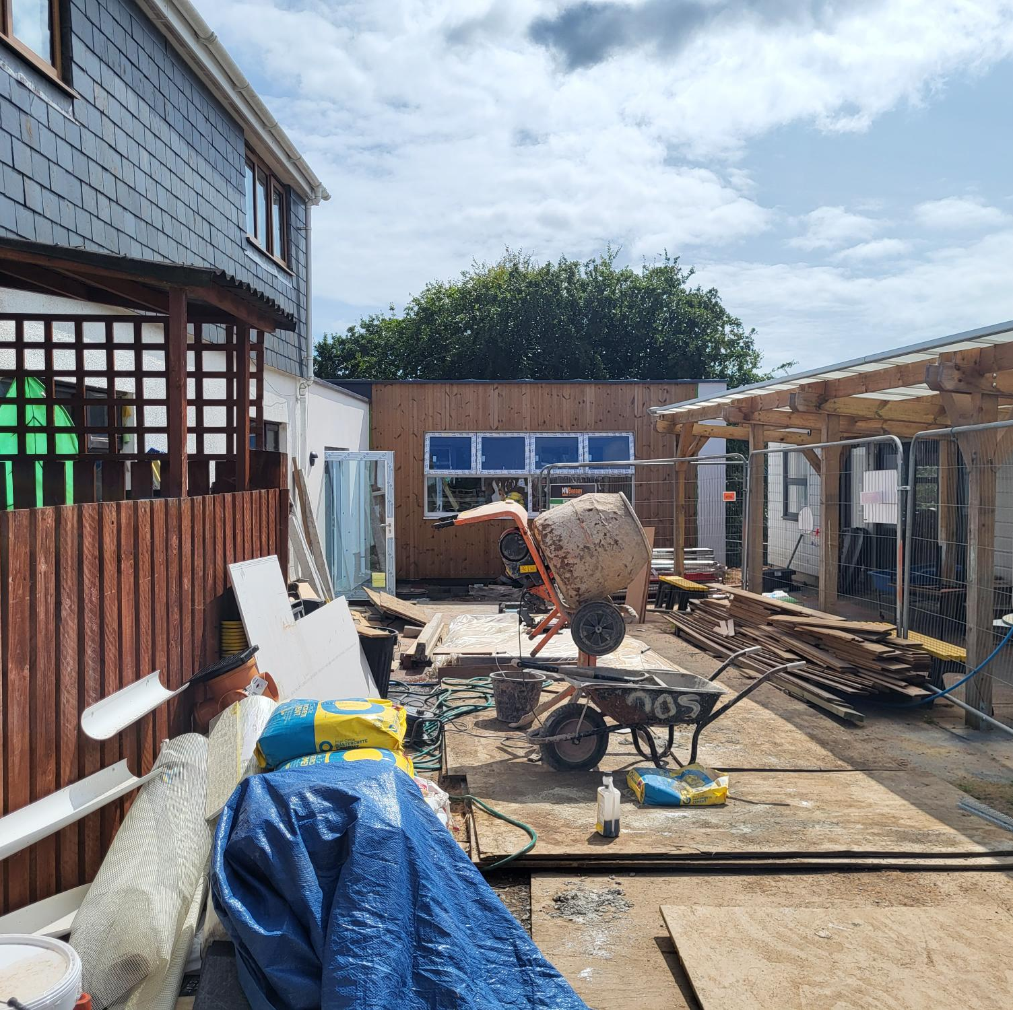
This is the outdoor learning space for Pre-school and our Early Years pupils.
It will have a new soft pour tarmac surface when cleared which will enable our youngest pupils to explore learning in a safe outdoor space.

Slide 8
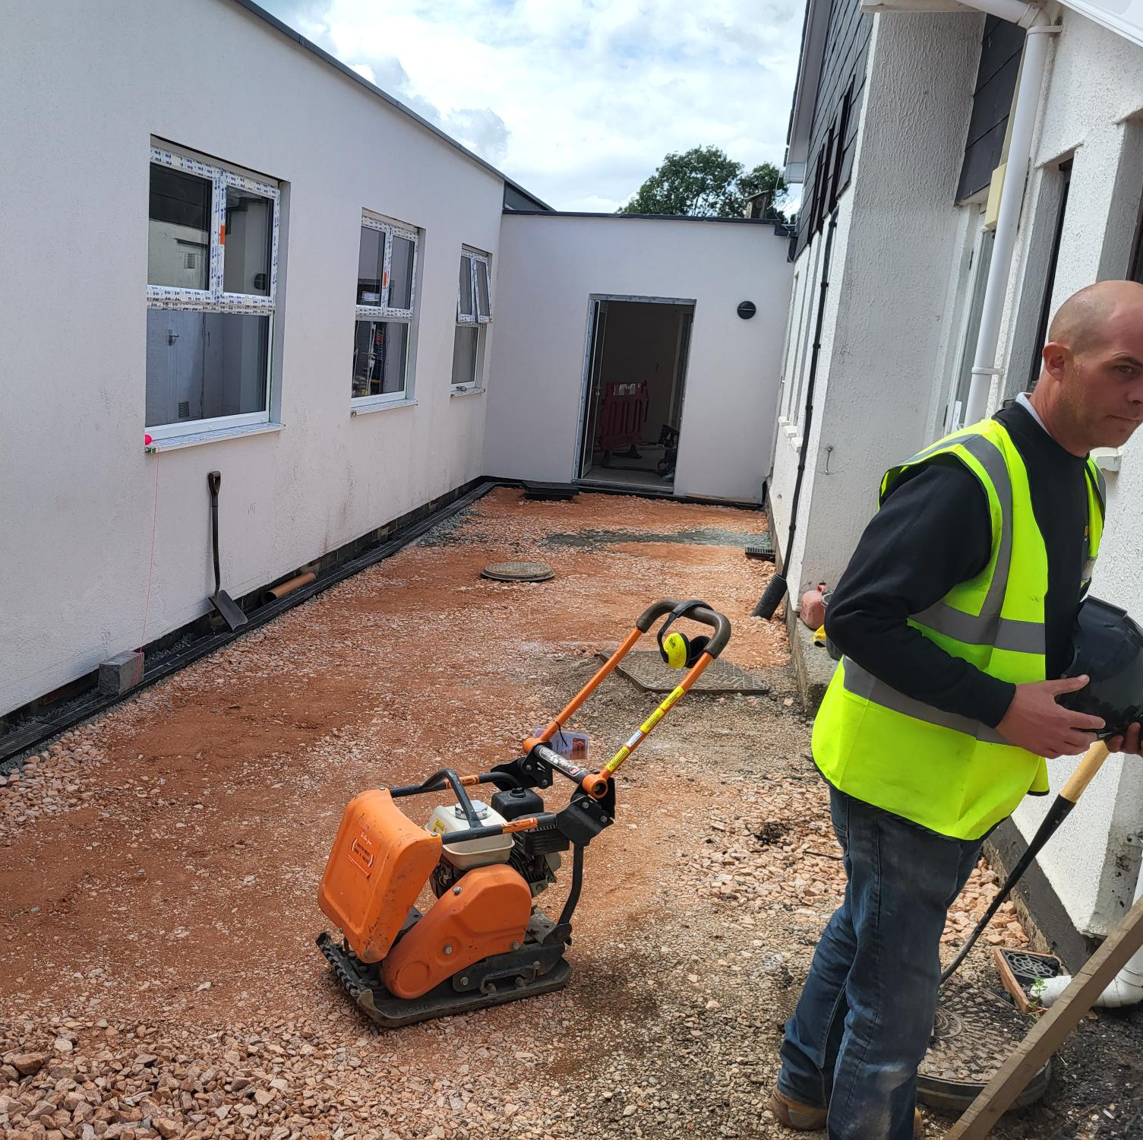
The space between the main school and the new classrooms has been levelled, with new drains put in.
The external pathways have been regraded and will be tarmacked before pupils return.
The main school has been completely redecorated to ensure we now have the learning space our pupils deserve!

Slide 9
Hennock Primary School
Hennock has been in desperate need of extensive external works and last year missed out on CIF funding for a new roof and windows by a tiny margin. This year the CIF bid was successful, and the roof and windows are being replaced with the school providing just a percentage of the actual cost of this work.
We also applied for a fire-safety upgrade which includes compartmentalisation, and this application was also successful, so builders have been really busy at Hennock this summer!
With both projects we will be reconfiguring the main school, redecorating and improving the flooring etc to ensure the school has a real face-lift!
Once the builders have completed the main works, we will have the external walls of the school redecorated

Slide 10
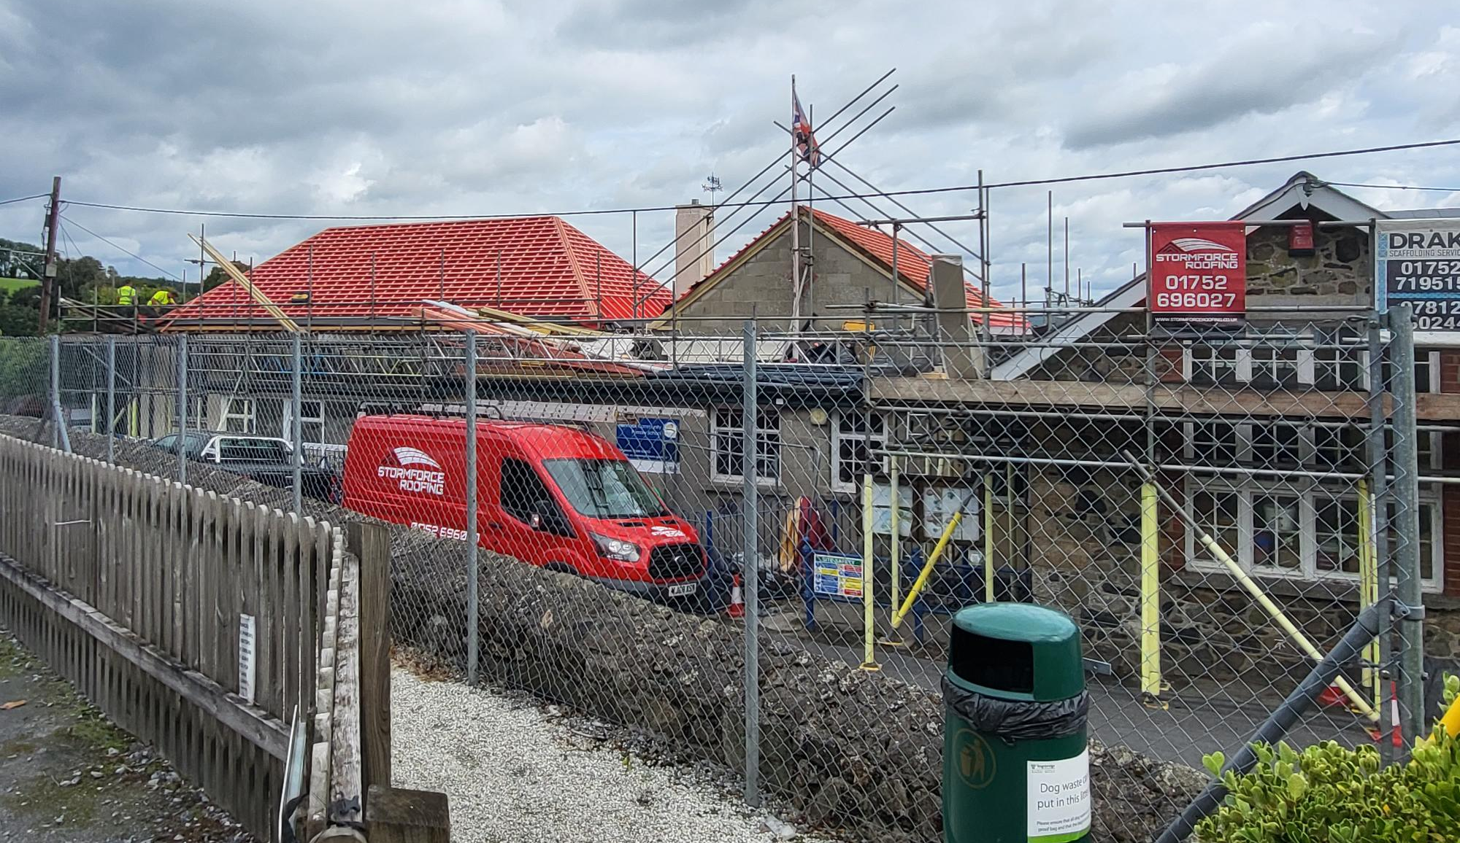
The major project has been the replacement pitched and flat roofs.
Stormforce has worked hard to complete the roof over the main hall to enable the scaffolding to be removed from this area first to free-up parking in the village- it looks very smart!

Slide 11
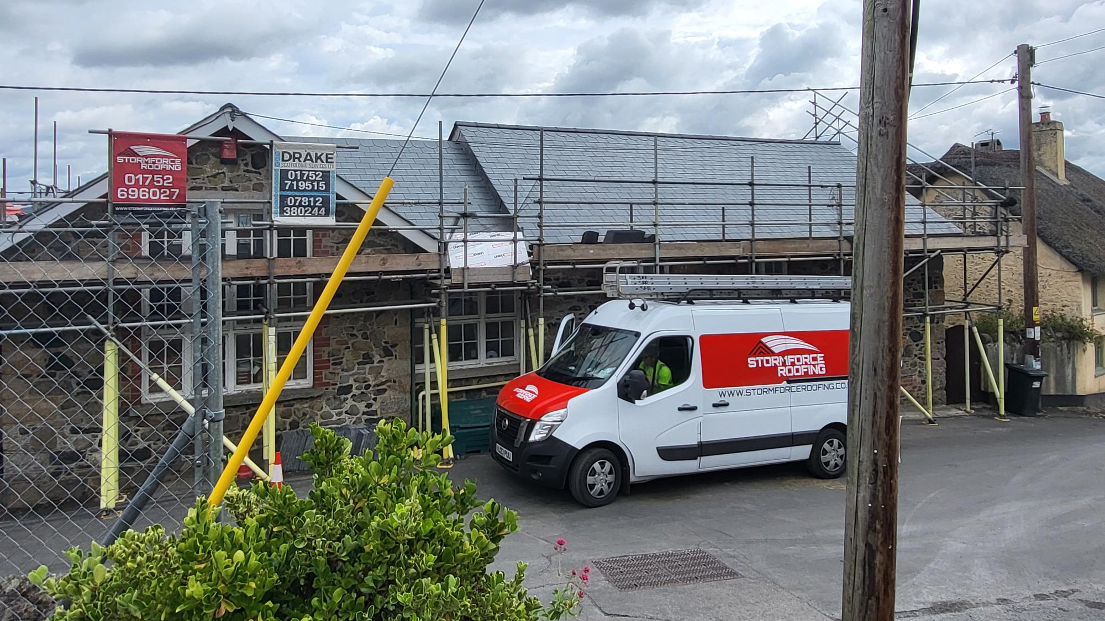

Slide 12
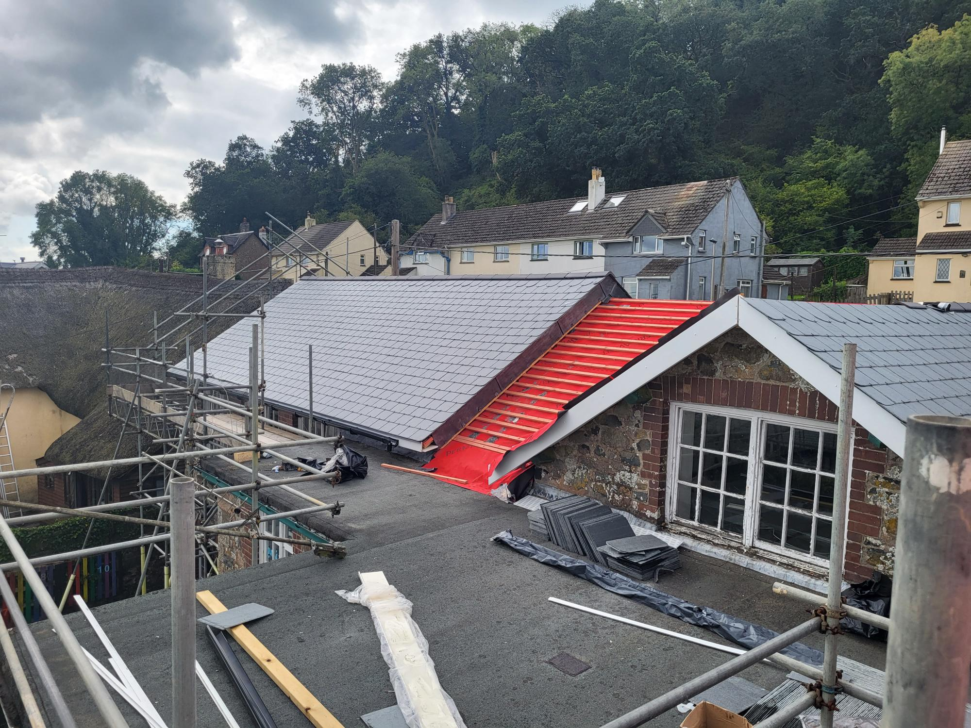

Slide 13
Replacement Windows will follow the completion of the Roof
The work required to put new windows in will happen once the roof part of the project is complete and will be managed as the term progresses

Slide 14
Internal fire safety works to include fire doors, compartmentation and fire alarm system
To do this as effectively as possible, we have reconfigured space within the school which will give additional classroom space

Slide 15
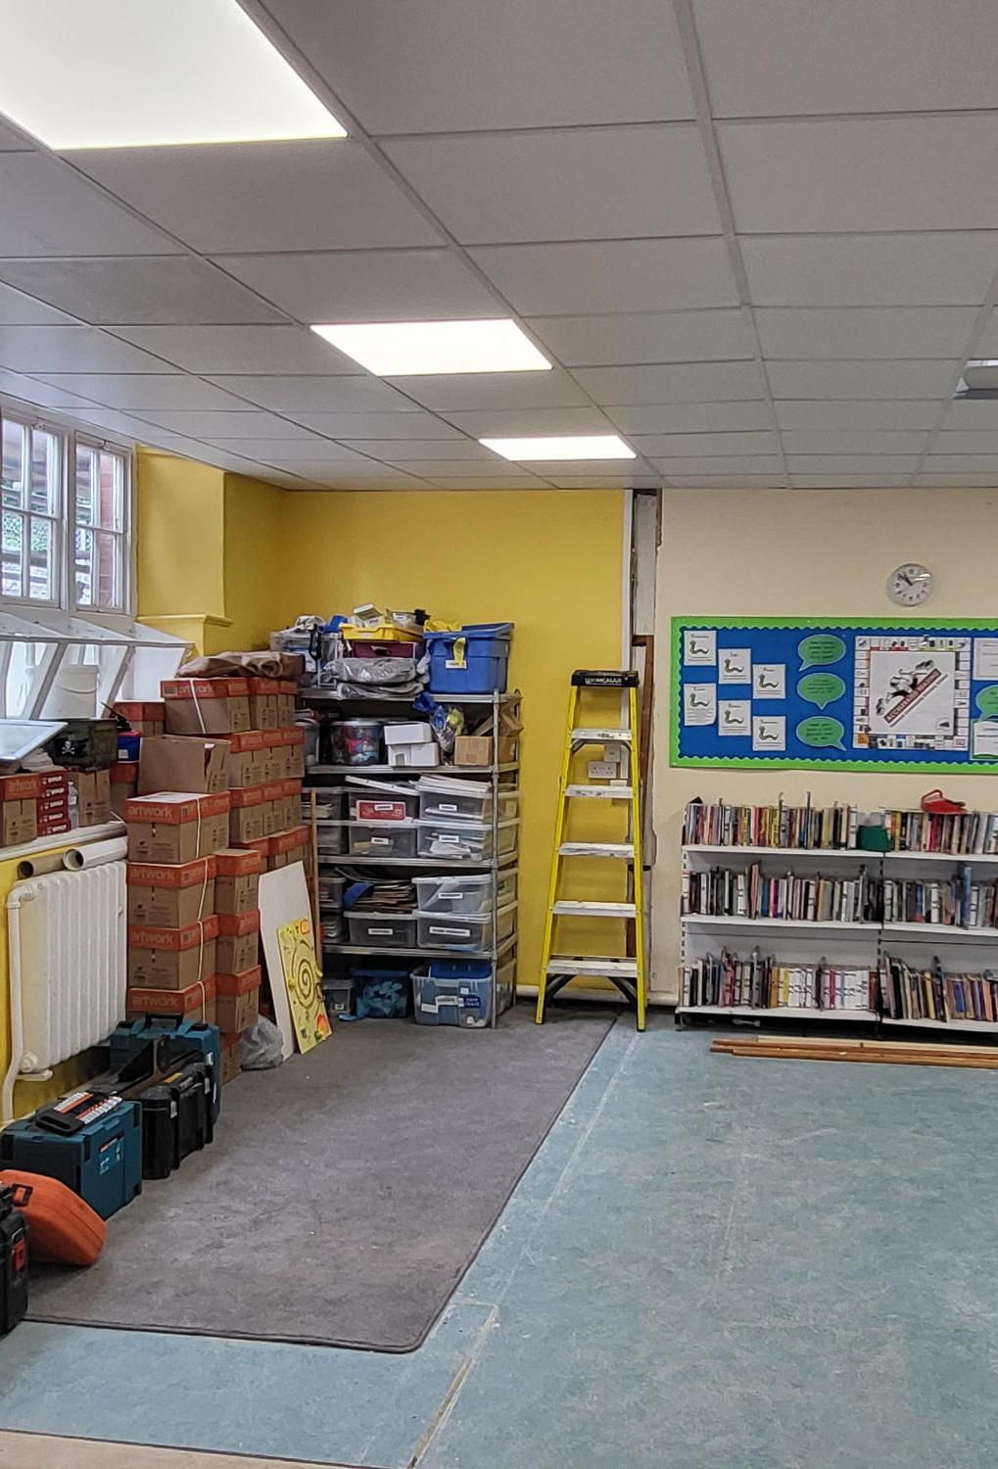
The old library and office space has been opened up to create a new classroom.
Part of the work requires new fire doors, and this gave us the opportunity to make adjustments to the partition walls.
Re-decoration, flooring and general improvements will make a significant difference and provide more learning space.
There will be a lot to do to get everything back in place for September start- but really worth it!

Slide 16
New fire doors throughout
All the doors throughout the building are being replaced with fire doors, this includes the door surrounds and redecoration.

Slide 17
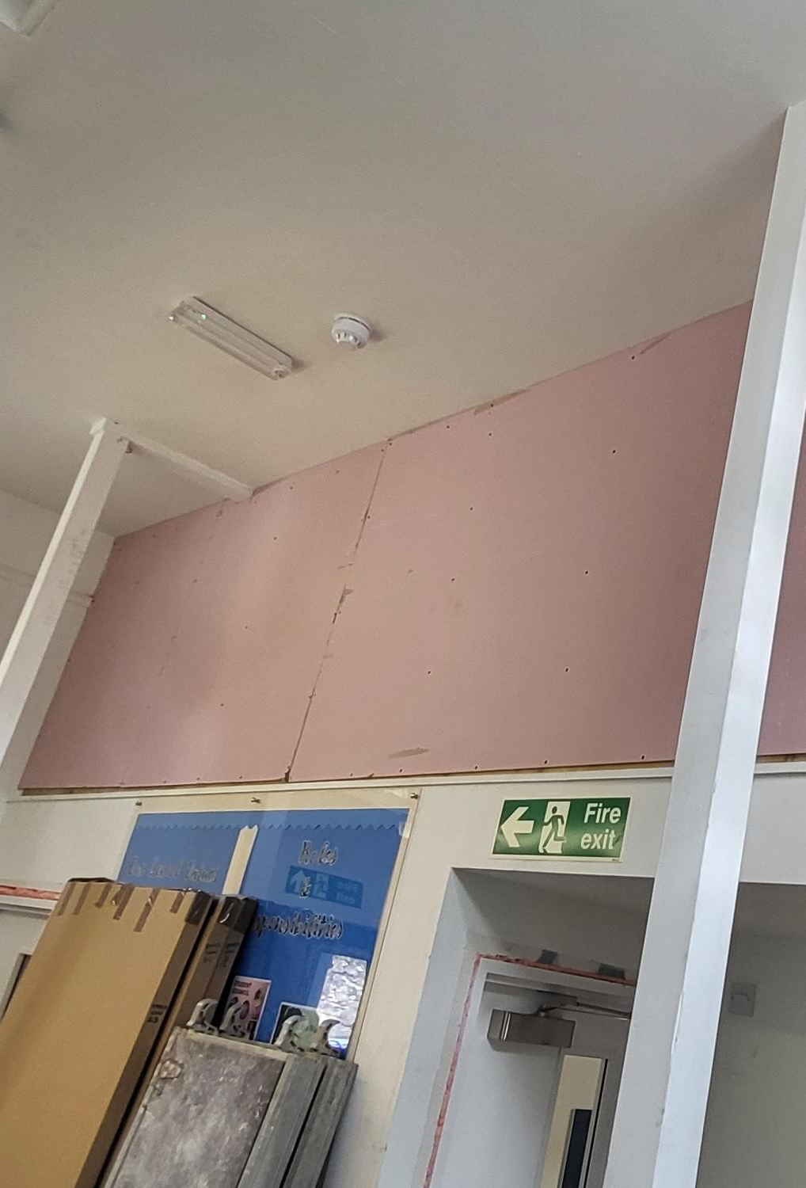
Mezzanine storage area- fire compartmentalised
The mezzanine area has required significant work to ensure it is compartmentalised. It remains a really useful storage area with much better access than we had before.

Slide 18
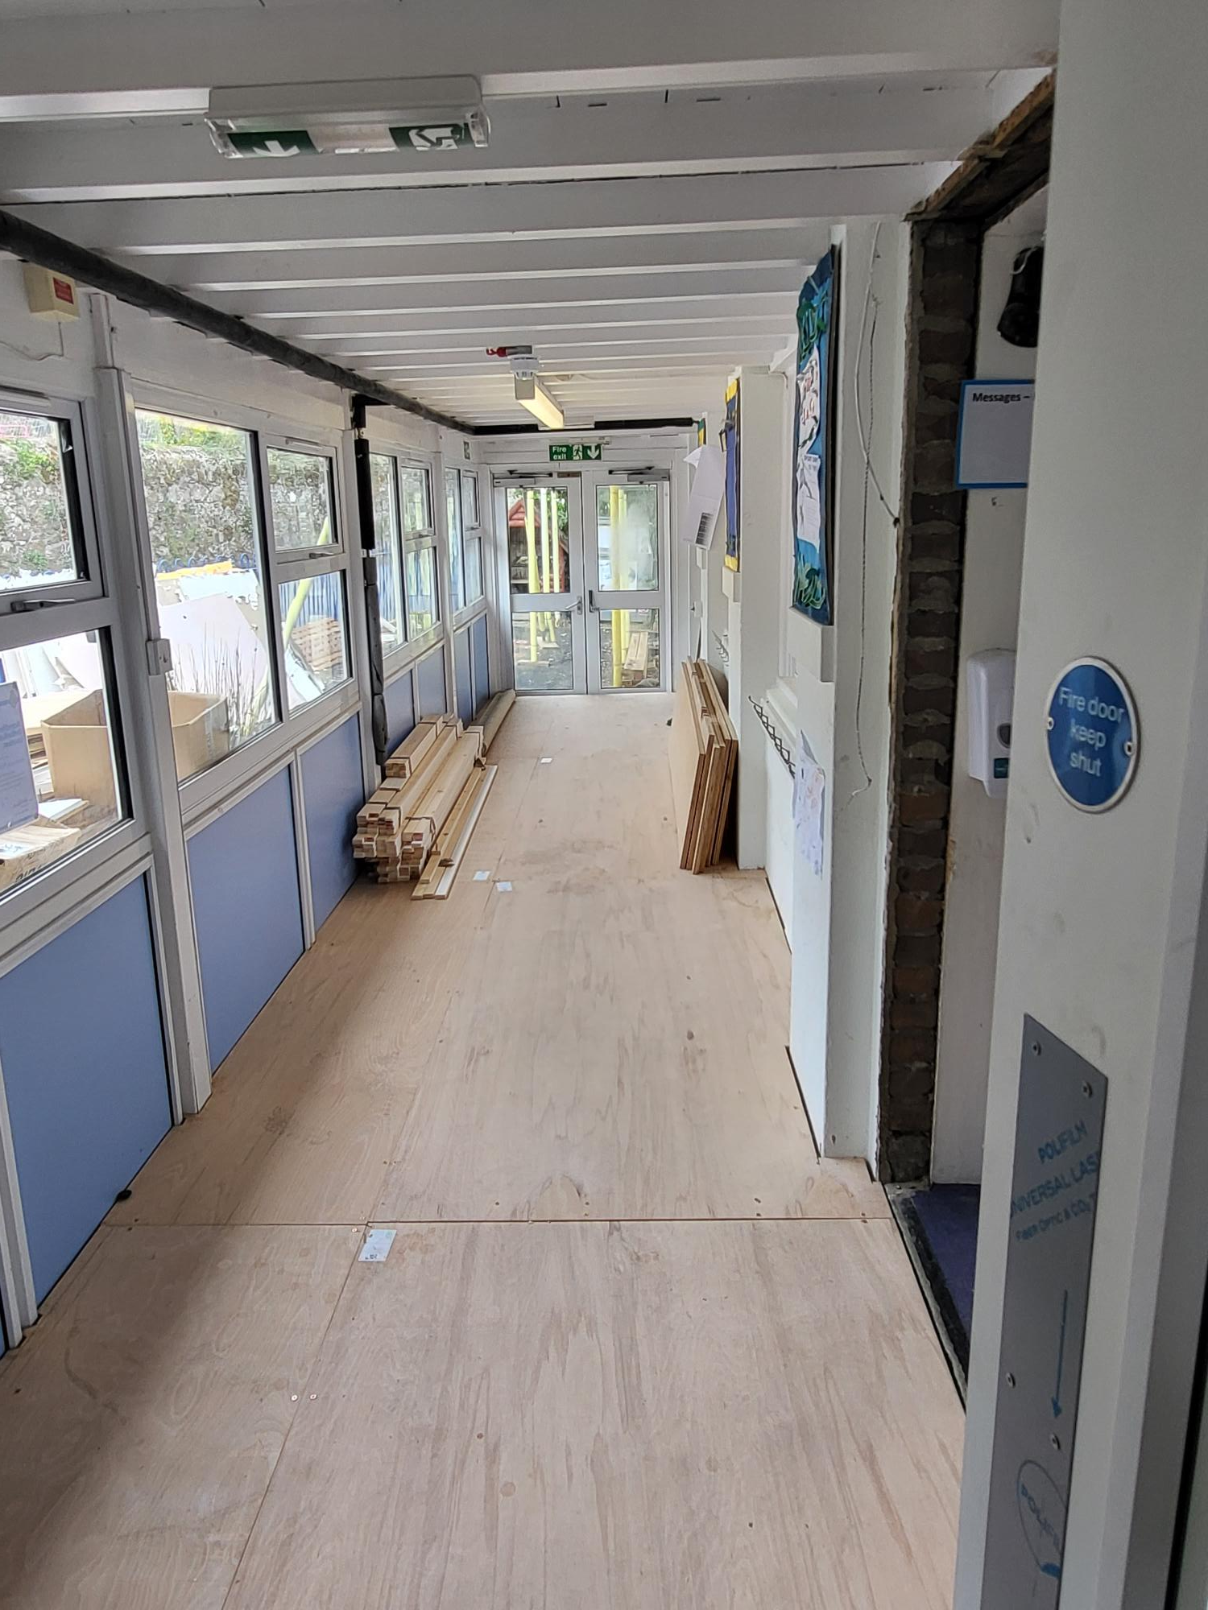
The passage between the two main classrooms has been heightened to remove the step up/down.
The floor has been raised, so new emergency exit doors are to be installed with disabled ramp externally.
The whole area will have new carpet tiles
An electric fire alarm system will make a real difference.
As in all schools with this level of work happening in the summer, we will be working hard in the last days of the summer break to get classrooms organised.

Slide 19
Morchard Bishop Primary School
Last year we completed a deep clean and redecoration following a review of resources and furniture within the school- throwing out poor quality items. This year we were successful with a CIF bid to make improvements to the overall heating system.
Morchard Bishop has always had significant heating problems, but this summer has had a state-of the art air source heat pump system installed to keep us all warm this winter!

Slide 20
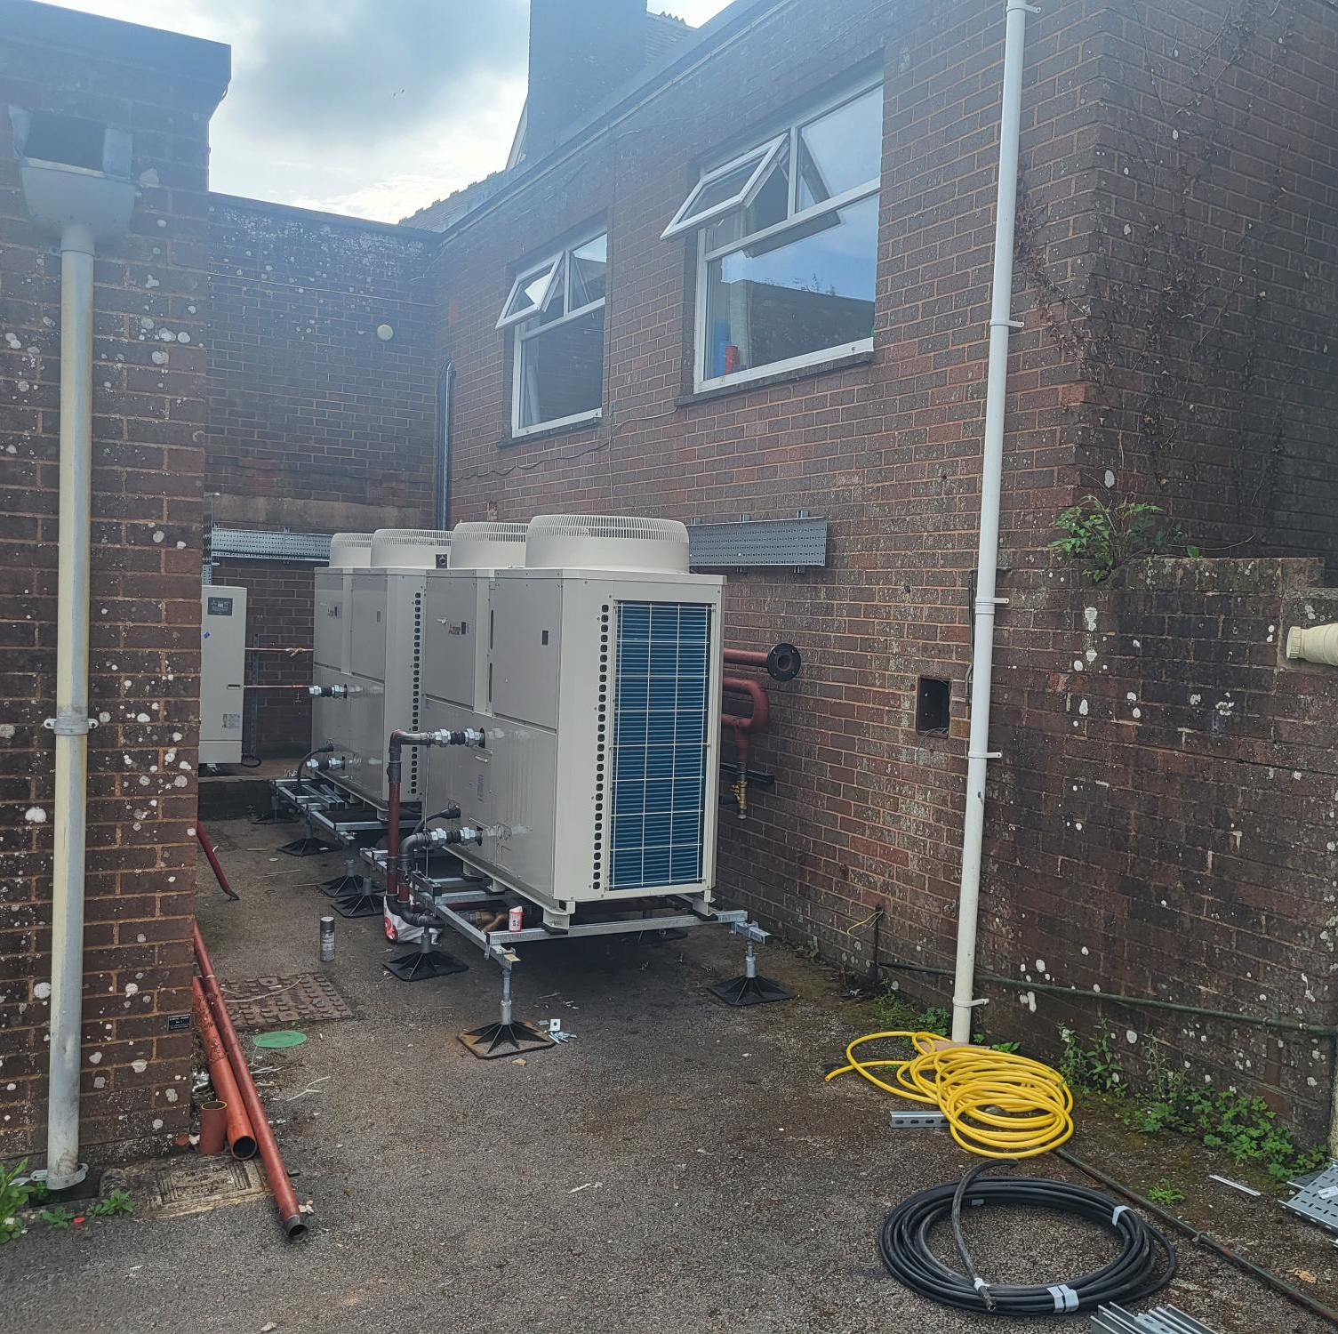
The new Airsource heat pumps fitted
Using a space that is really redundant the big units were put in place.
This system is also an important and major improvement in the actions we plan as part of the Trust Sustainable Plan.

Slide 21
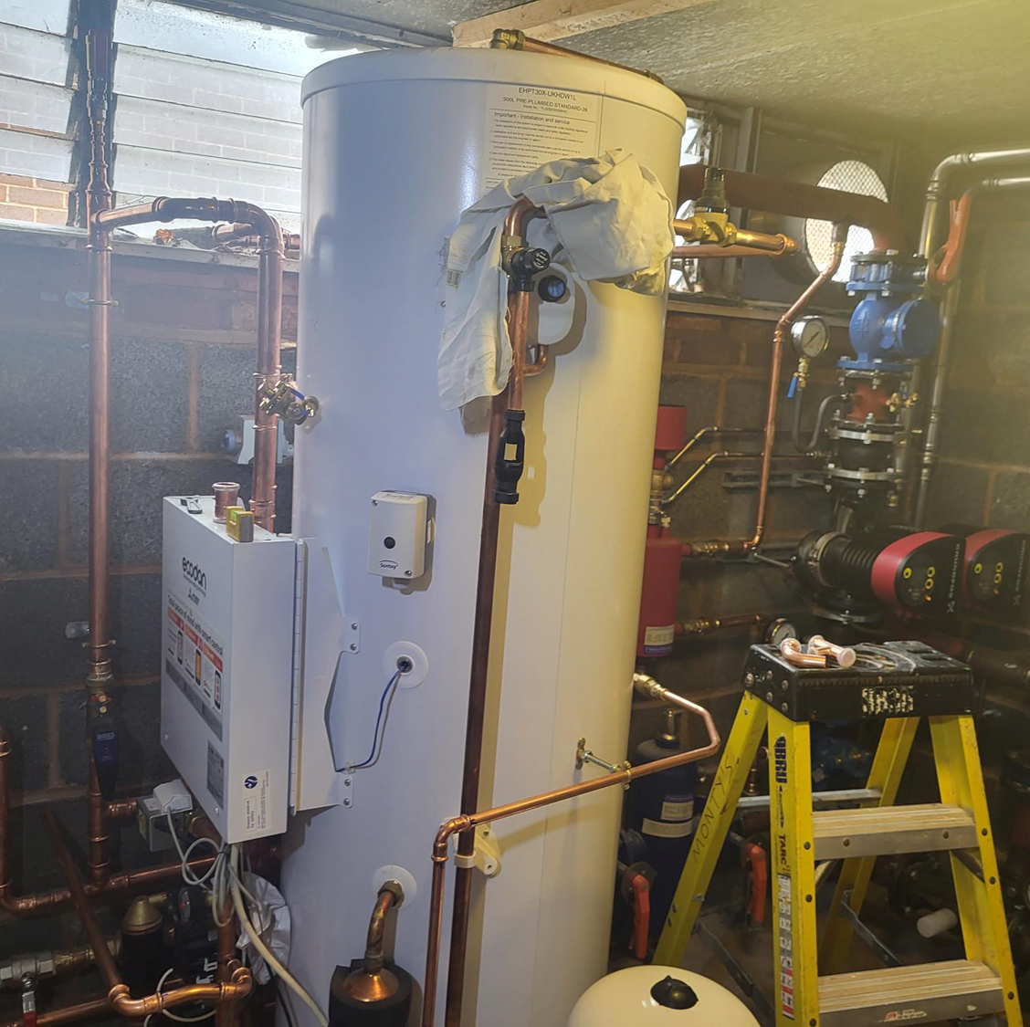
Boiler room reconfigured
The new boiler fitted and the whole system has been reconfigured to give us a really effective and economical system.

Slide 22
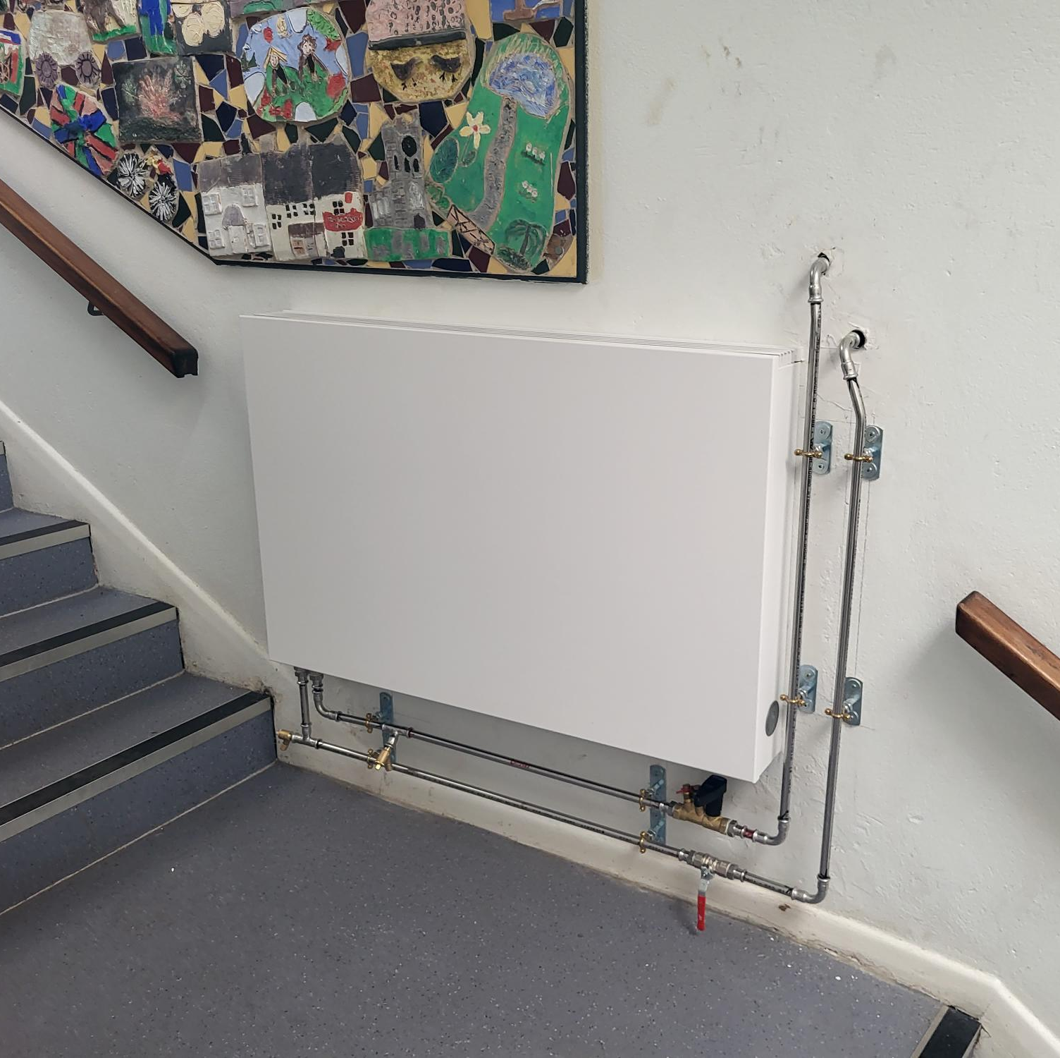
New radiators installed throughout the school
Slim-line radiators are now in place

Slide 23
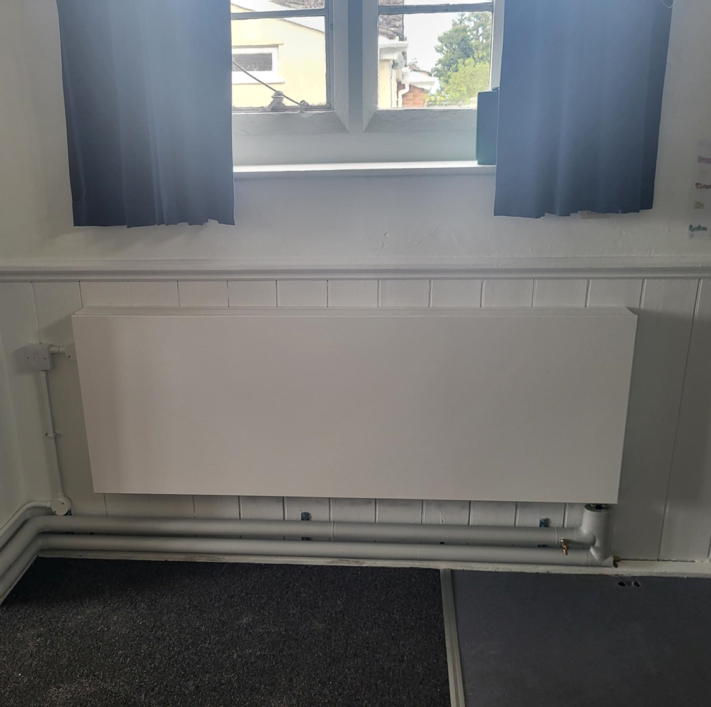
Pipework surface mounted and clad.

Slide 24
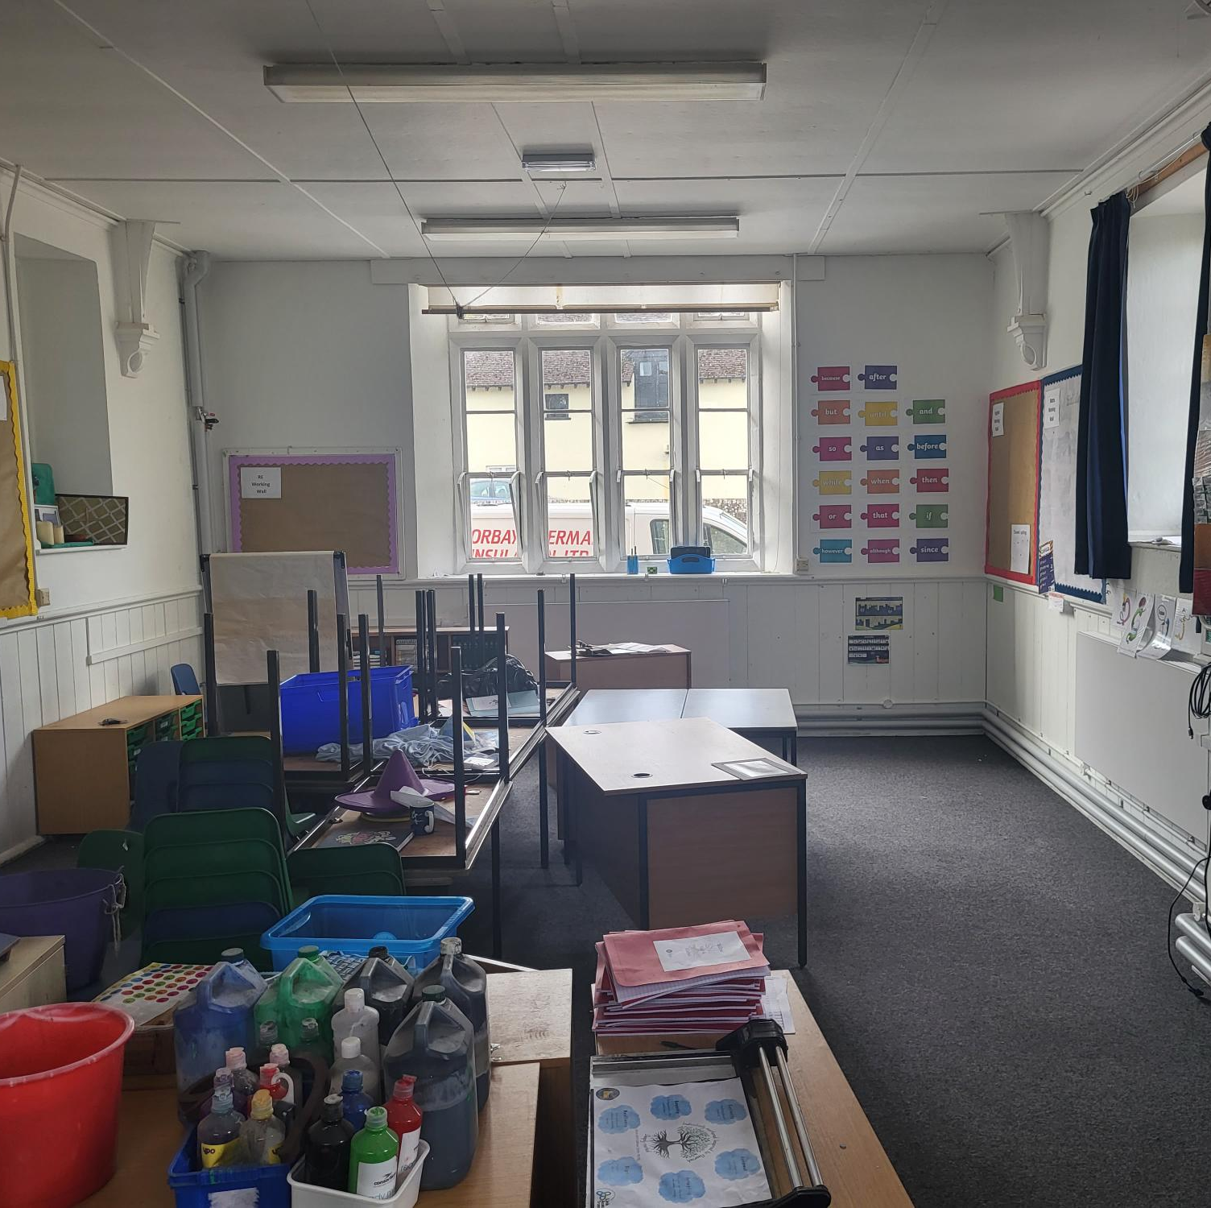
Classrooms to be put back together.
As with all our schools that have had work projects going on during the summer holidays there is quite a lot of work to do- once the cleaners have completed deep- cleans to get the classrooms ready for the children to return!

Slide 25
Widecombe-in-the-Moor Primary School
Widecombe-in-the-Moor also had a successful CIF bid enabling us to completely renew the roof. Again, this was a significant project in terms of cost with the Trust contributing a fraction of the outlay required for such an extensive job.
It was clear that while this work was taking place the Trust should take advantage of the disruption to reconfigure a large area of wasted space, currently a series of cupboards and coat space to create more effective teaching space. Builders were unable to start as early as we had hoped and so this work will continue into the term. The advantage with Widecombe is that we have space in the School House which can be utilised on a temporary basis while this is completed. This development is funded wholly by the Trust and is in response to increasing numbers on roll.
The two projects will make a significant difference to the school as we are also able to make small changes that will have a big impact, for example- a door from the hall into the kitchen!

Slide 26
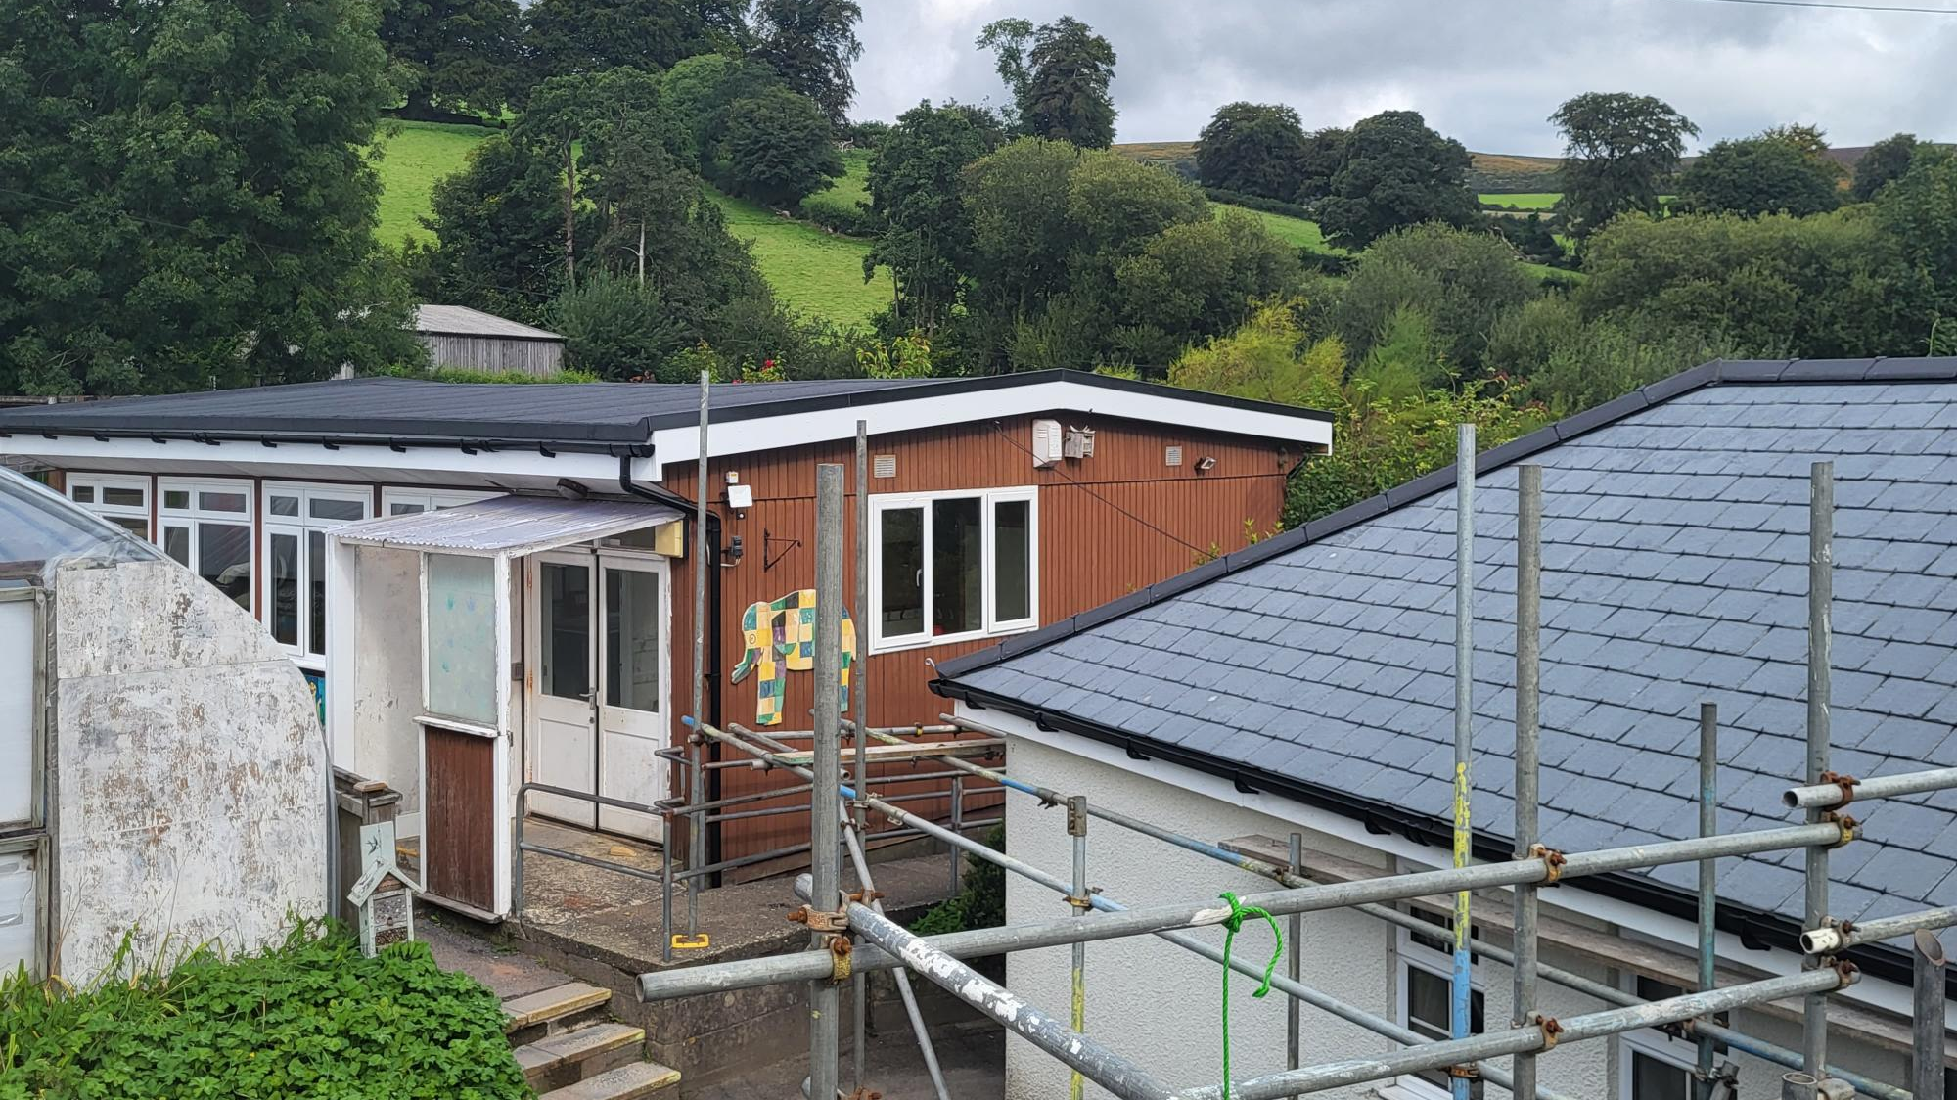
New flat roof for the Yr 1 / 2 classroom tidies the whole building up

Slide 27
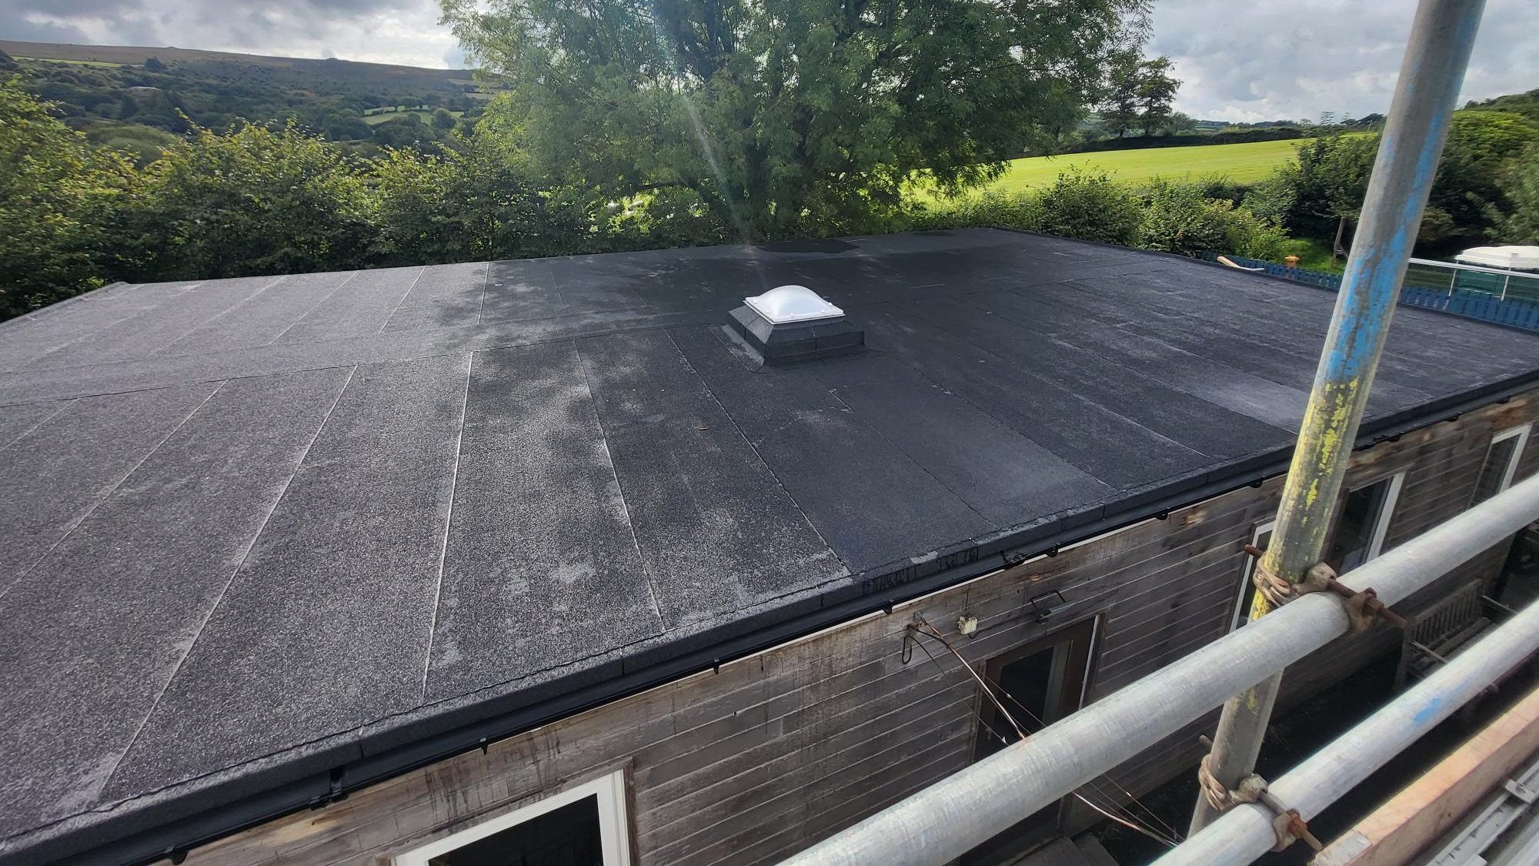
New flat roof for the Yr 3/4 & 5/6 classrooms

Slide 28
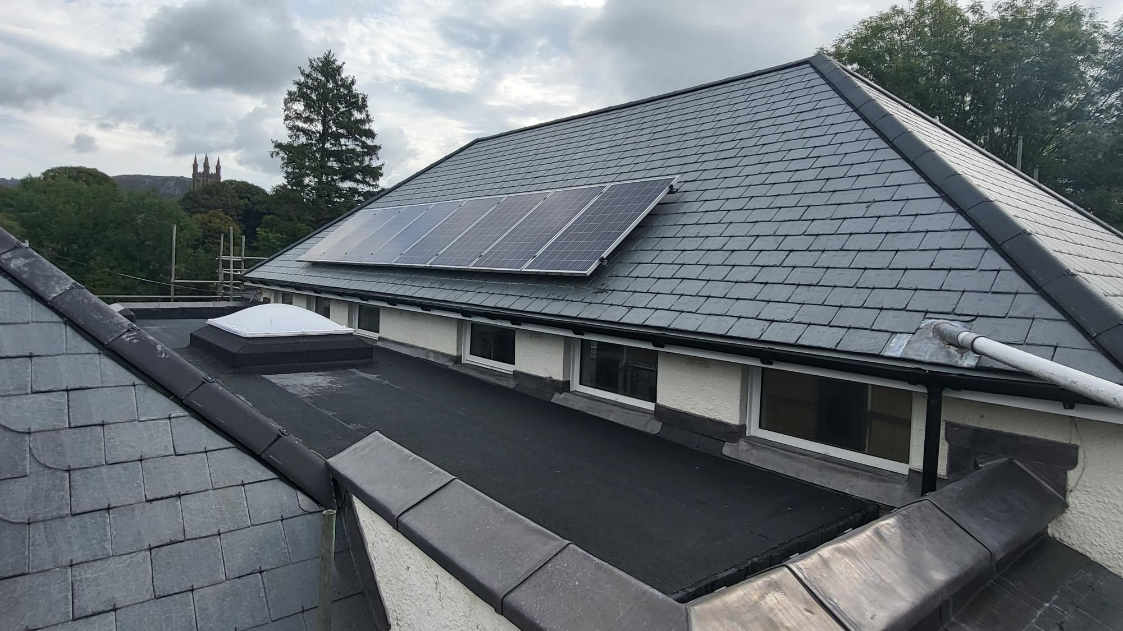
New flat and pitched roof to Reception class and main hall- with solar panels- another step forward with the Link Sustainability Plan

Slide 29
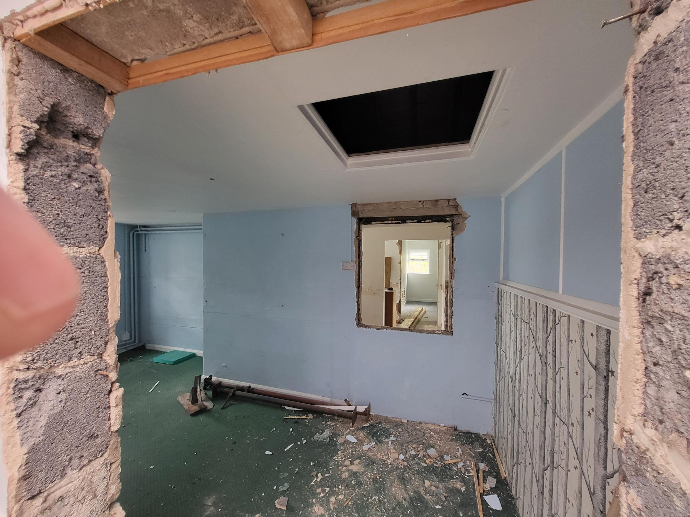
Worked commenced on knocking through to create a new, larger Reception classroom and toilets. Access to outdoor learning will be part of the project. The new space will be redecorated with new flooring and IT Smartboard etc.
As normal there will be significant work for teachers in setting up the new classrooms once they are complete.
Work commenced on knocking through to create a new Reception class and toilets.

Slide 30
Stoke Gabriel
Sorry no pictures- but the school is having a complete overhaul of Fire Safety with a new alarm system, automatic kitchen shutter closure and compartmentalisation.
Stoke has had a number of successful CIF bids previously, including windows and heating so we were very pleased that this bid was also successful.
It will be completed before children return.

Slide 31
The Link Academy Estates- summary
This year the success of 5 CIF bids, our own Trust-funded projects and the Urgent Capital Support funding loan for Diptford have seen over £1.2 million pounds spent on our school buildings during 2022-23 academic year. This has led to a significant improvement in many of our schools that were in desperate need of this investment. We intend to continue to complete the projects that are underway with a programme of redecoration etc and address any ongoing areas that require future work.
We have a designated Estates Manager starting with the Link in September- Ross Cooper. He will be picking up from Matt to ensure the planned work is completed as well as setting up a detailed Sustainable Plan with a programme to instigate continued actions. He will also look into a number of grants that are becoming available to enable the Trust to continue to improve our schools in a sustainable way, involving wherever possible, the children’s voice.

